Slide 1


Week 2
Messaging
Part 1
DCS, SMCS
Internet of Things
IoT
Faisal Iradat

Slide 2
Topics
Basics of IoT Wireless Networking
Describe and compare the major protocols
Discuss how they can be used in the IoT space

Slide 3
IoT Protocols
Protocols are a set of rules for transmitting data between electronic devices according to a preset agreement regarding information structure and how each side will send and receive data.
IoT protocols are standards that enable the exchange and transmission of data between the Internet and devices at the edge.
IoT protocols can be divided into two categories
IoT network protocols
Provide methods of connecting IoT edge devices with other edge devices or the Internet
IoT data protocols.
Focus on information exchange

Slide 4
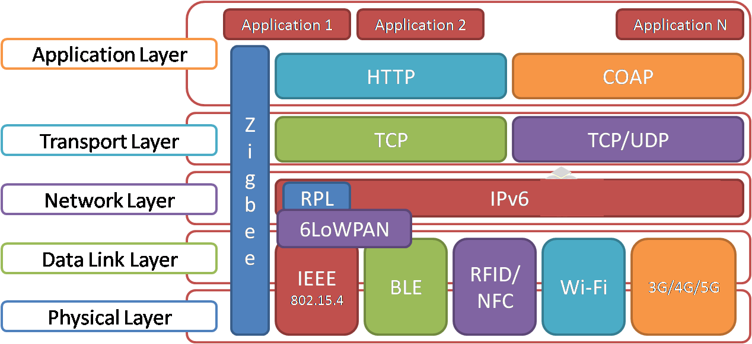
IoT Network Protocols
Wi-Fi
LTE CAT 1
LTE CAT M1
NB-IoT
Bluetooth
ZigBee
LoRaWAN

Slide 5
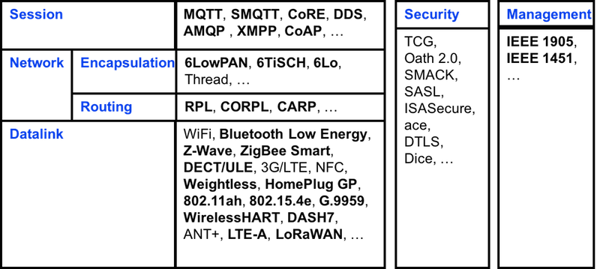
IoT Data Protocols
AMQP
MQTT
HTTP
CoAP
DDS
LwM2M
Details in the next class

Slide 6
Application Layer Protocols
Rapidly increasing IoT devices
Magnitude and rate at which data is generated
Challenge
Finding and deploying messaging protocols that exchange messages more efficiently
Application layer protocols are considered as the underlying layers used by applications
Defining the structure of message exchanges
How they can be transmitted

Slide 7
Communication / Middleware Protocols
Commonly used in the deployment of IoT applications
HyperText Transfer Protocol (HTTP)
Message Queuing Telemetry Transport (MQTT)
Advanced Message Queuing Protocol (AMQP)
Constrained Application Protocol (CoAP)
Extensible Messaging and Presence Protocol (XMPP)
Data Distribution Service (DDS)
Among others
Features
Similar features in terms of connectivity
Vary in the degree to which these features are offered

Slide 8
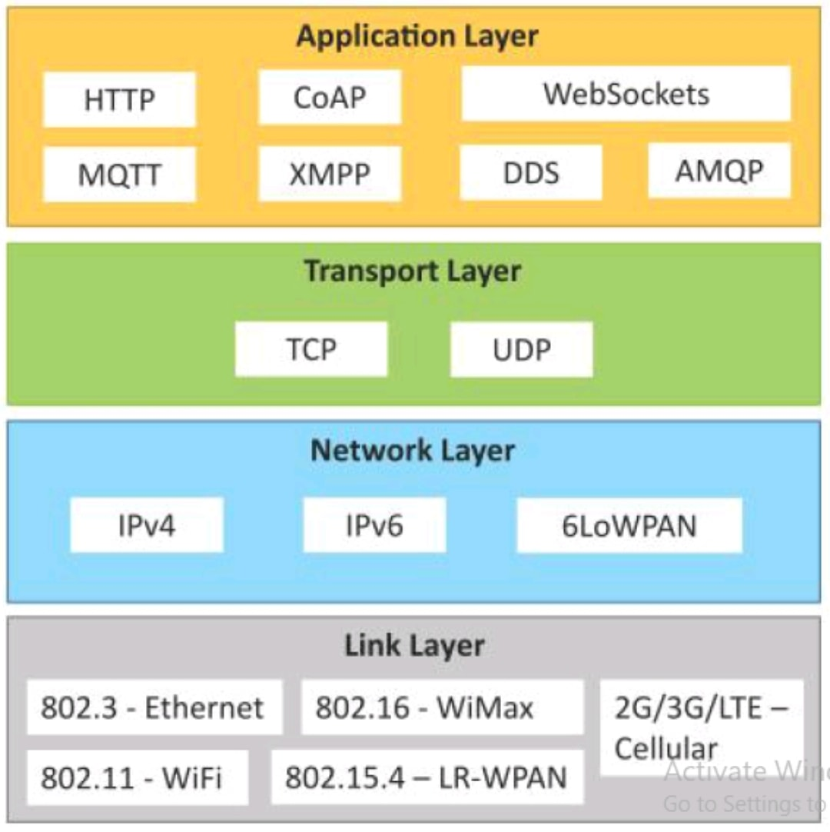
Choosing the protocol
Challenge
Consider the hardware characteristics of IoT devices
type of data link layer protocols employed
bandwidth they support
IoT devices do not use a universal radio technology
Data rate varies considerably depending on the size and hardware components used to build these devices
Example
Low-rate wireless personal area networks (LR-WPANs)
Leverage IEEE 802.15.4 PHY
Data rates up to 250 Kbps
Packet length of approximately 127 bytes

Slide 9
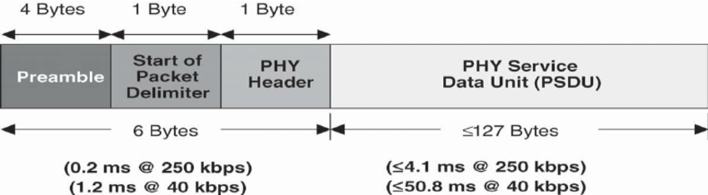

Slide 10
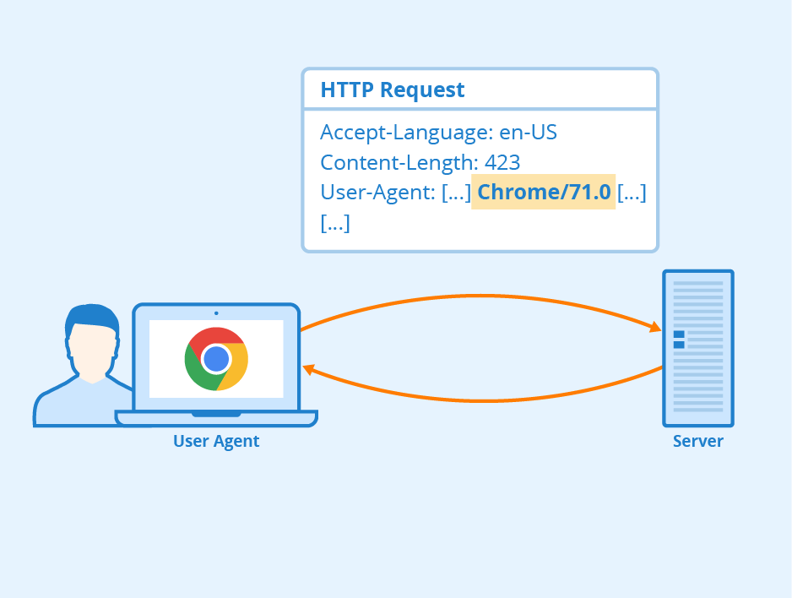
HTTP
A common request header size in HTTP
For example user-agent
700-800 bytes
Uncompressed request header
200 bytes to more than 2KB
Application layer protocols that are capable of capturing data much faster than actual physical data rates often leads to high latency.
Support for protocols that can accommodate physical data rates at the data link layer

Slide 11
Lightweighted Protcols
IOT devices producing data at a high velocity often require
Lightweight communication protocols e.g.
Battery-supported IoT temperature device programmed to send localized temperature readings at a fixed frequency (e.g. every 10 seconds) to an IoT hub (e.g. Microsoft Azure IoT Hub)
HTTP not a feasible option
Alternate
Message Queuing Telemetry Transport (MQTT)
Smallest packet size is 2 bytes compared to 200 bytes HTTP MQTT is a Machine-to-Machine (M2M)

Slide 12
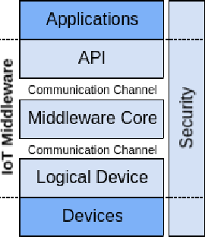
Performance
Significantly influenced by the choice of messaging protocol
Employing a suitable messaging protocol that
Reduce network traffic and latency
Increases IoT application’s reliability
No universal protocol that can be used across heterogeneous IoT environments
Choice - Messaging protocol depends
IoT application’s business requirements
Software capabilities
Device or hardware capabilities
Average size of data exchanges, among many others
Focus messaging or middleware protocols that are commonly used in deploying IoT systems

Slide 13
IoT MESSAGING PROTOCOLS
Traditional IoT cloud architecture
IoT devices relocate to the cloud for data accumulation (i.e. storage) and abstraction (i.e. aggregation and access).
IoT edge-based architecture
Reduces the amount of data in which only partial data relocates to the cloud for further storage and processing
Network and system architectures are generally responsible for not only collecting data at the edge of the network but also performing advanced functions such as
Data analysis and processing.
Data accumulation and abstraction partially shift from the cloud to the edge of the network
Significantly contributes to reduction in network traffic as the number of IoT devices increases.

Slide 14
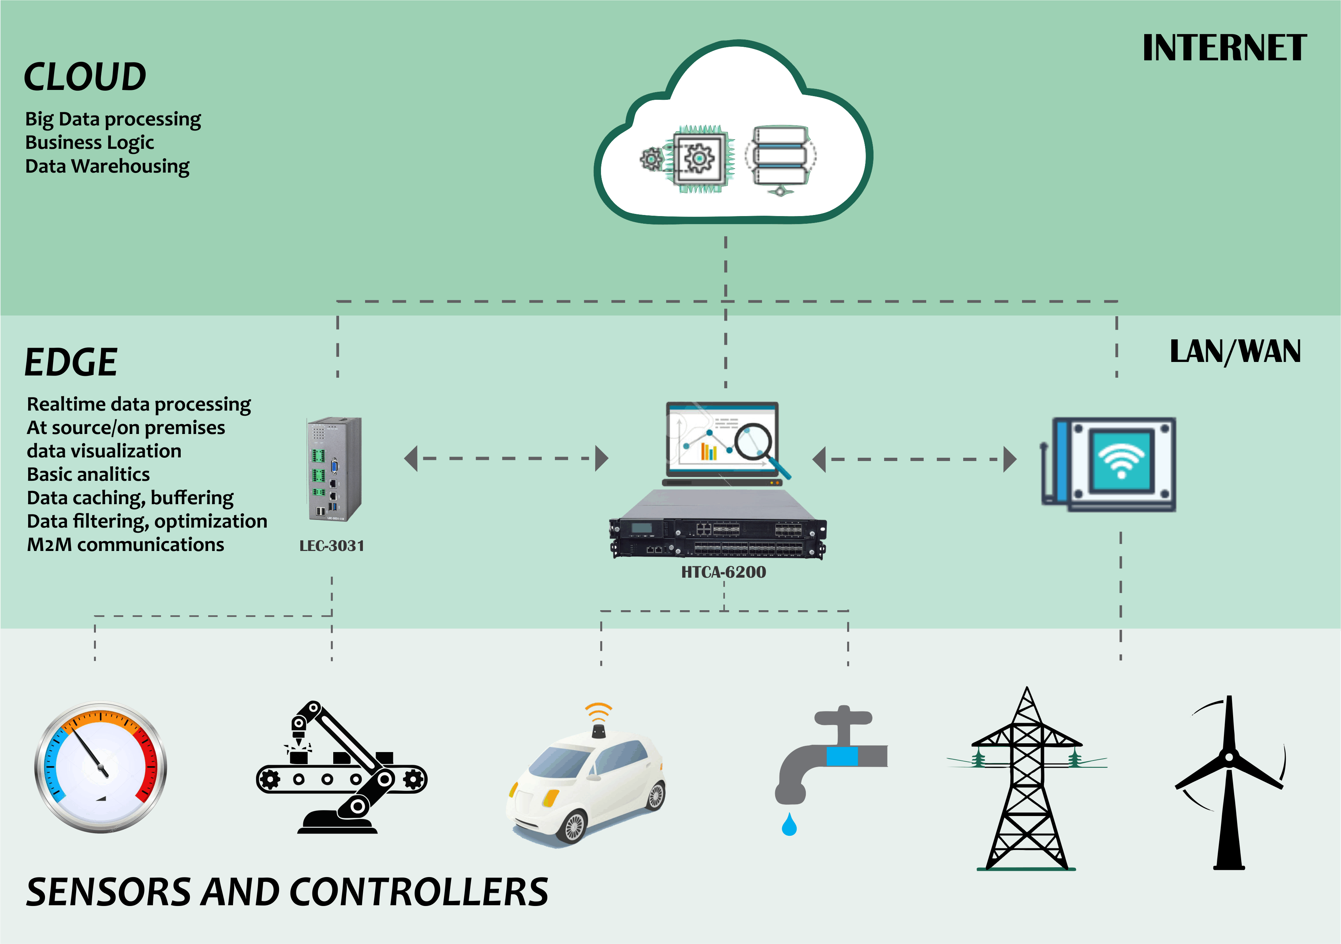

IoT edge-based

Slide 15
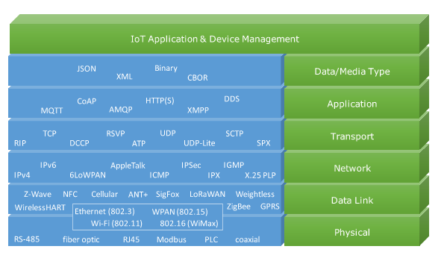
A communication-centric IoT reference model (CIoT)

Slide 16
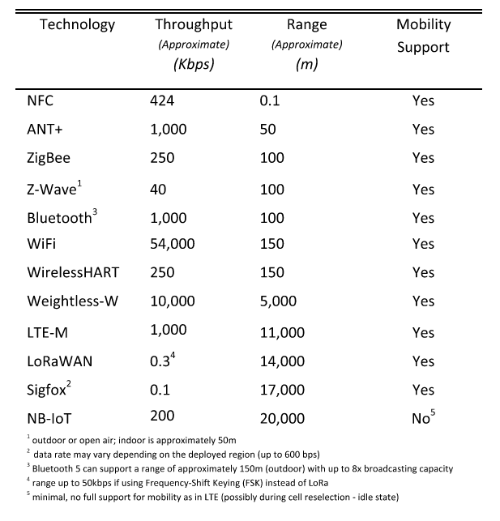

Slide 17
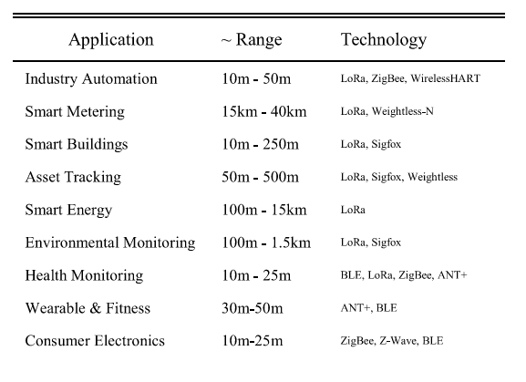

Slide 18
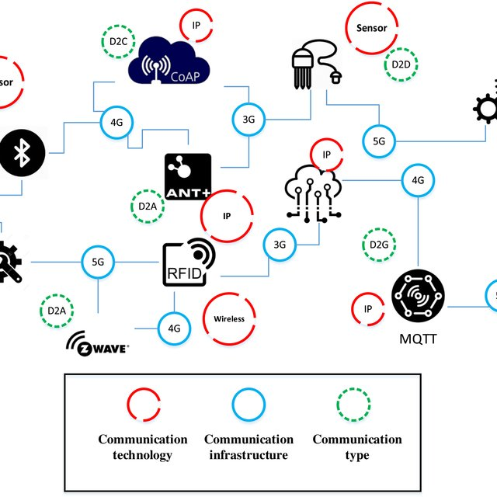
Messaging Protocols
Messaging protocols that support IoT data exchange
Device-to-Device (D2D) where communication is provided between two nodes or devices directly.
Device-to-Application (D2A) where communication is performed between devices and an IoT application.
Device-to-Gateway (D2G) where communication is provided through a gateway that resides in close proximity to the edge of the network while interacting with IoT devices.
Device-to-Cloud (D2C) where communication is achieved directly between IoT devices and cloud service providers.

Slide 19
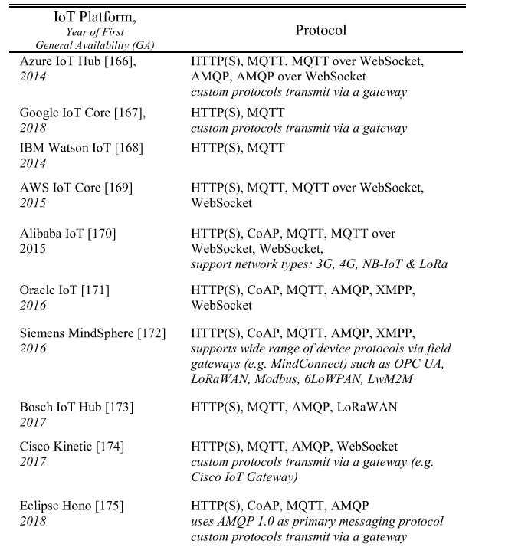
SUPPORT FOR IoT MESSAGING PROTOCOLS ON THE CLOUD

Slide 20
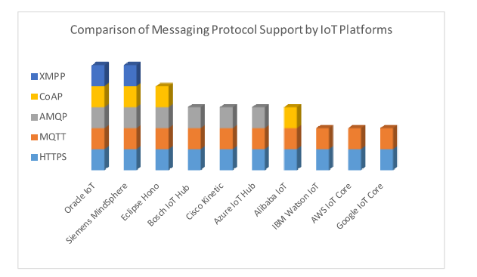
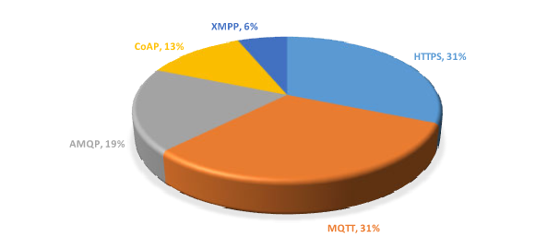


Slide 21
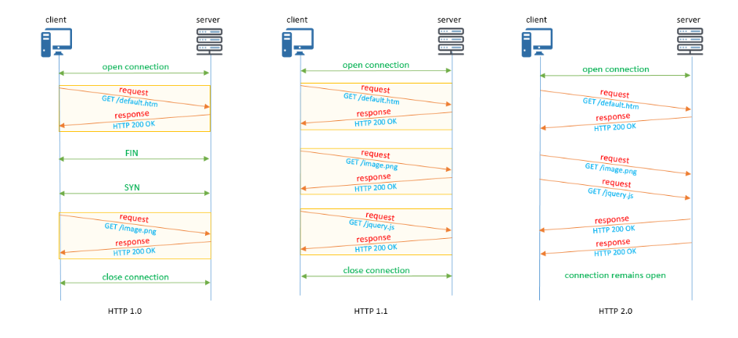
HTTP
Application-level, generic, stateless protocol
Used generally for data communication over the World Wide Web
HTTP is content negotiation of data representation
Enables different heterogeneous devices built independently of the data to be shared

Slide 22
CONSTRAINED APPLICATION PROTOCOL (CoAP)
A web transfer protocol that is intended for devices running on constrained (e.g., low-power, lossy) networks
Constrained devices
8-bit microcontrollers
Small amount of memory
Designed for Machine-toMachine (M2M) applications
Factory automation
Smart energy
Similar to HTTP, CoAP is a request-response interaction model and uses major concepts from the web such as Uniform Resource Identifiers (URIs) and Internet media types
CoAP aims to bridge HTTP and RESTful services through simple interfacing.
Quick exercise:
What are REST and RESTful services

Slide 23
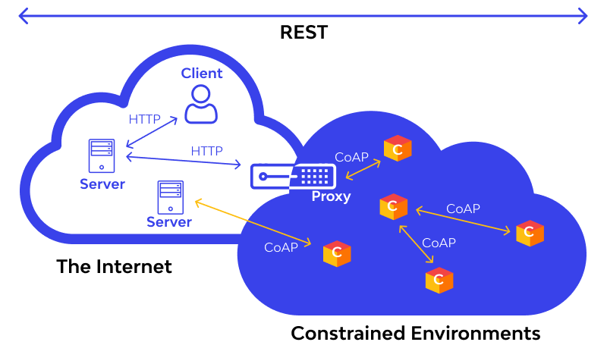
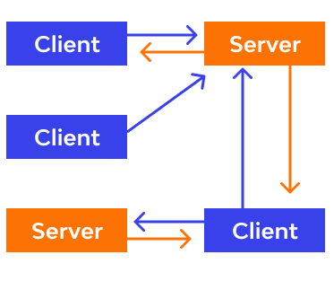
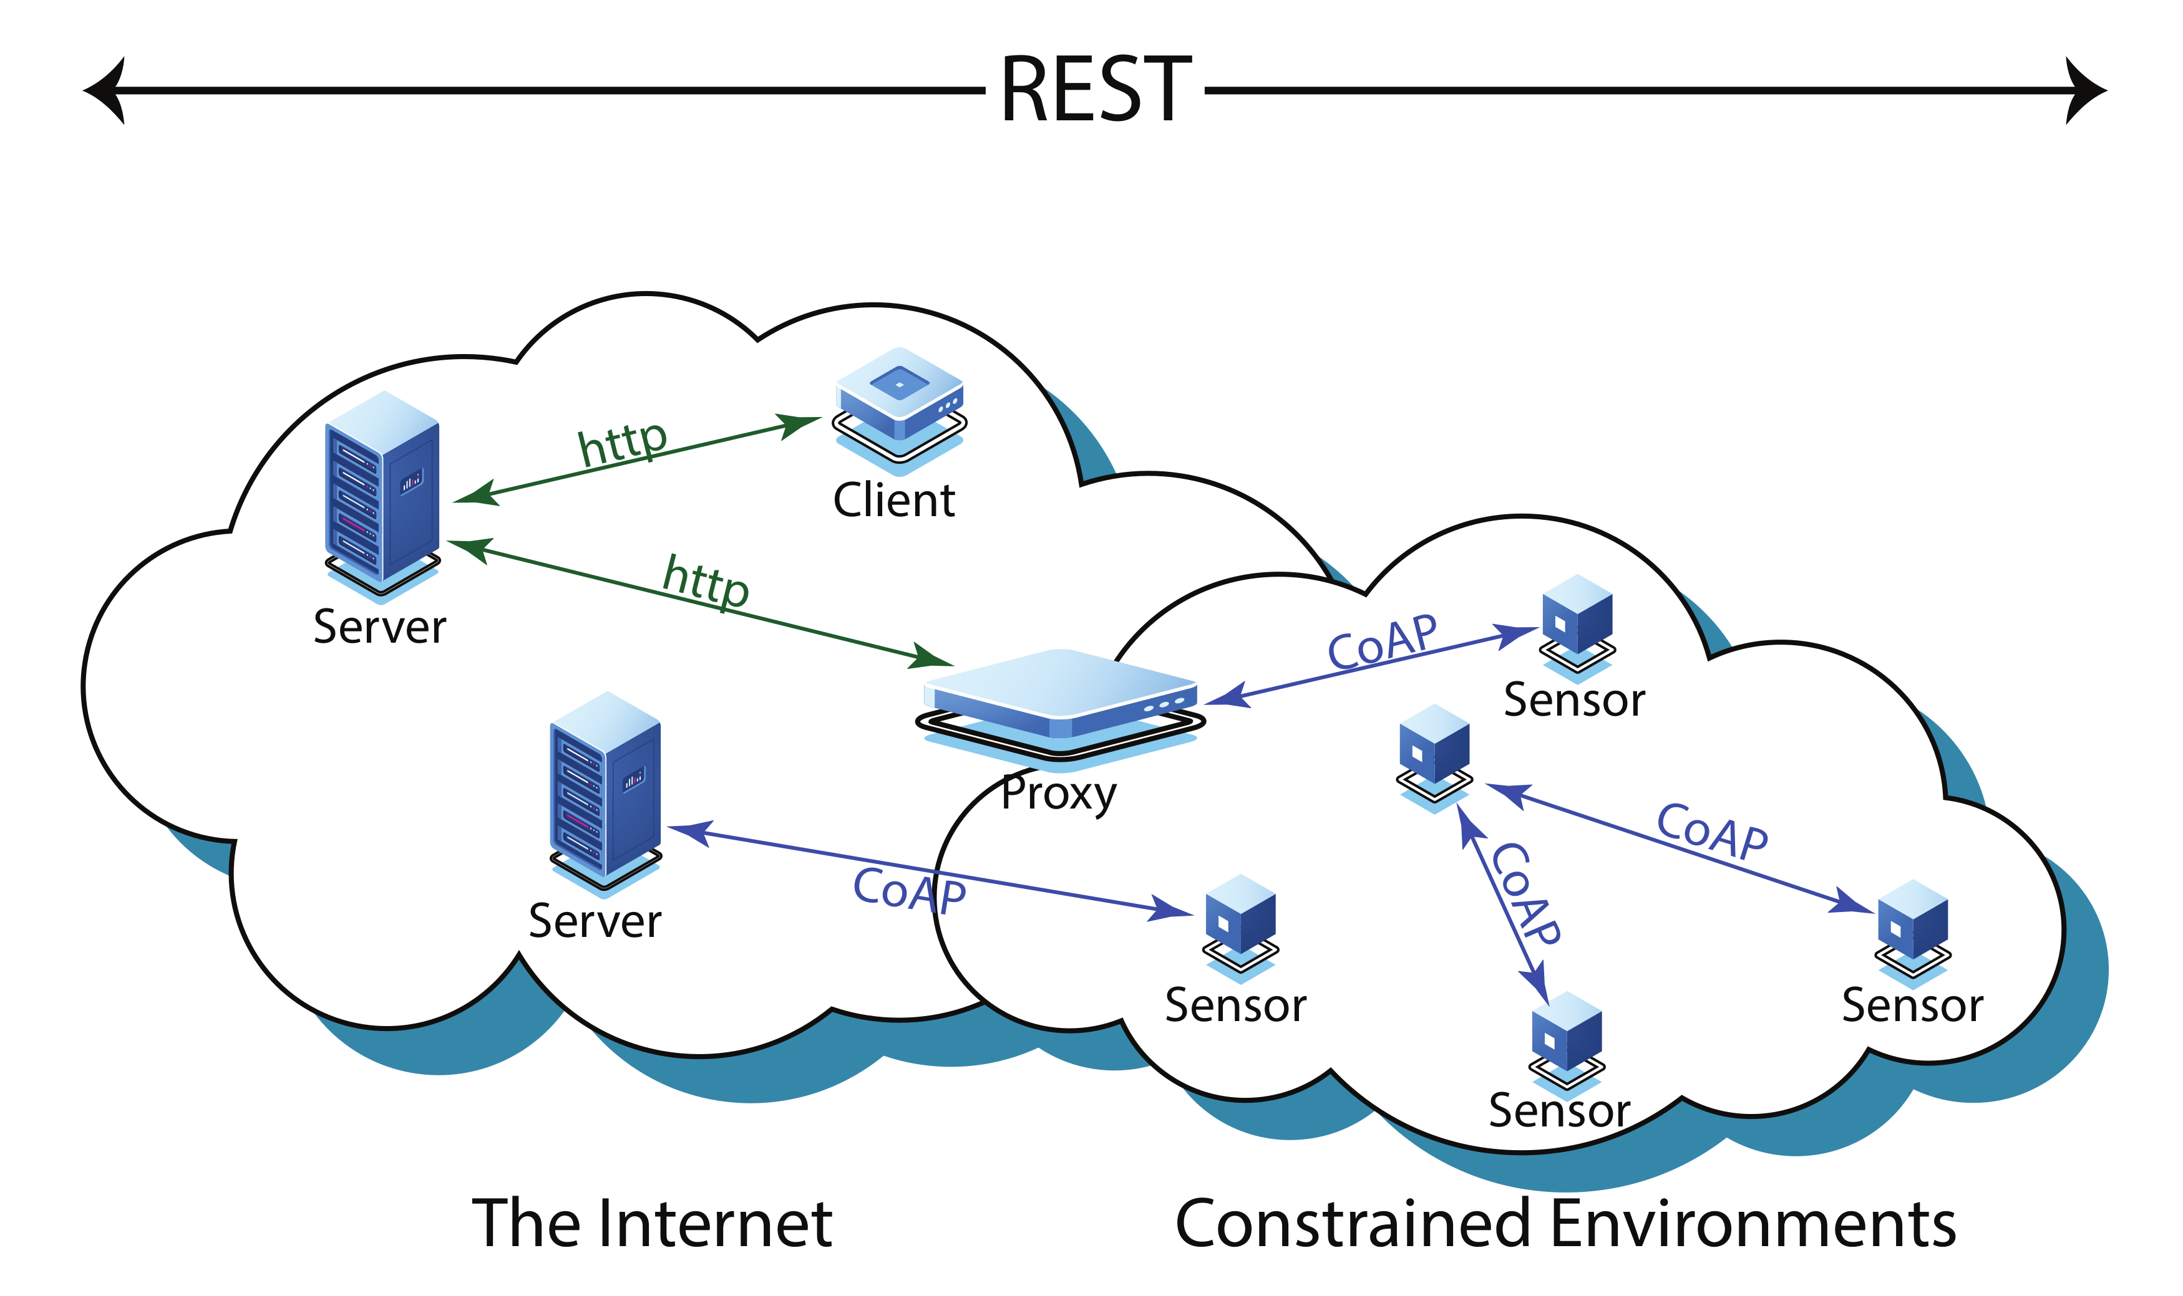

Slide 24
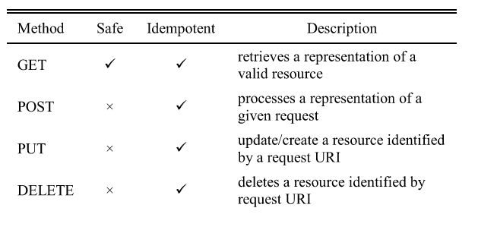
CoAP Methods

Slide 25
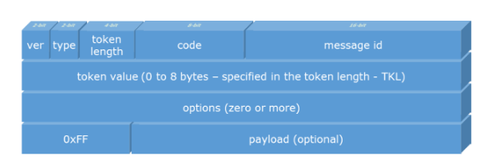
CoAP Message

Slide 26
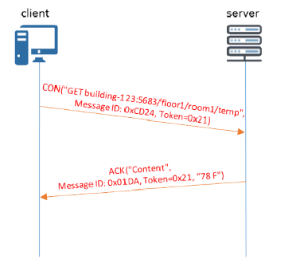
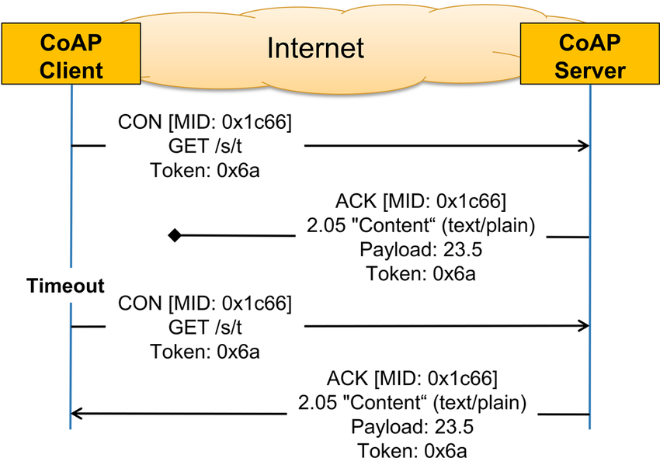
CoAP Message Exchange

Slide 27
IoTivity
Open source software framework that enables device-to-device communication, uses CoAP as its application layer

Slide 28
MQTT
Need for a lightweight protocol that is designed to handle situations in cases of unreliable networks or intermittent connectivity
MQTT
MESSAGE QUEUING TELEMETRY TRANSPORT
OASIS standard
Publish-subscribe lightweight messaging protocol designed for constrained devices
Enabling the exchange of data with the cloud in a realtime manner
MQTT, an application layer protocol designed for Machine-to-Machine (M2M)
Uses a publish-subscribe model
Runs on top of the Transmission Control Protocol

Slide 29
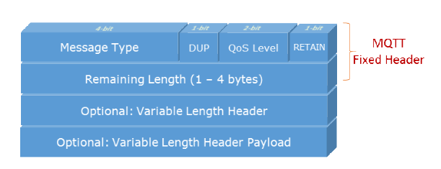
MQTT Message

Slide 30
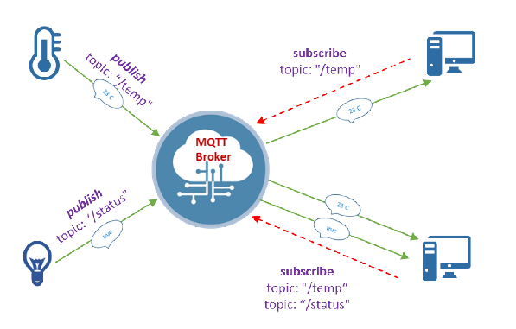
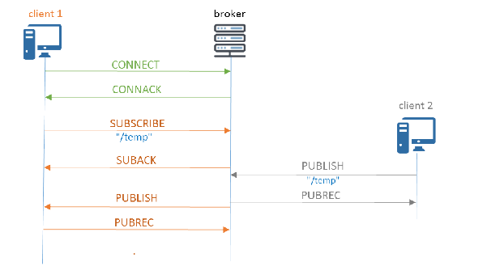
Centralized Broker Model

Slide 31
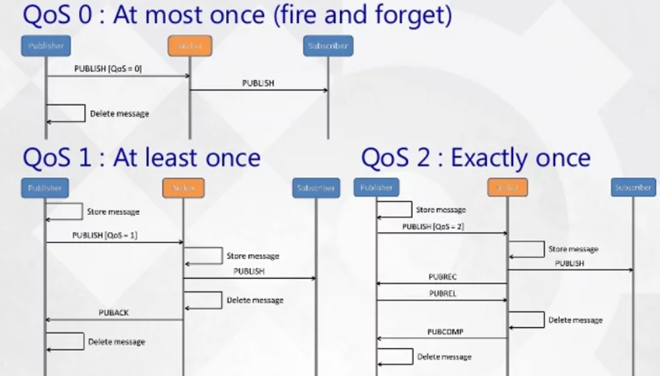
QoS

Slide 32
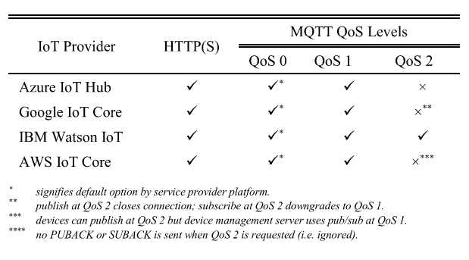
Support

Slide 33
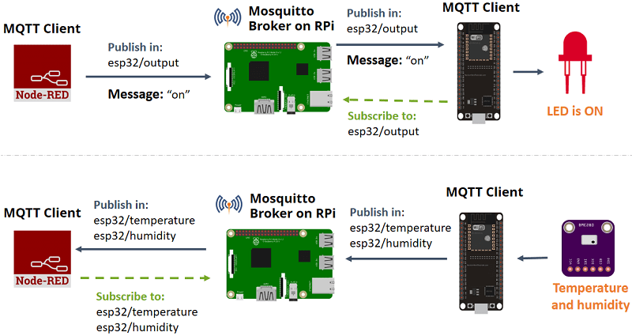
Scenario

Slide 34
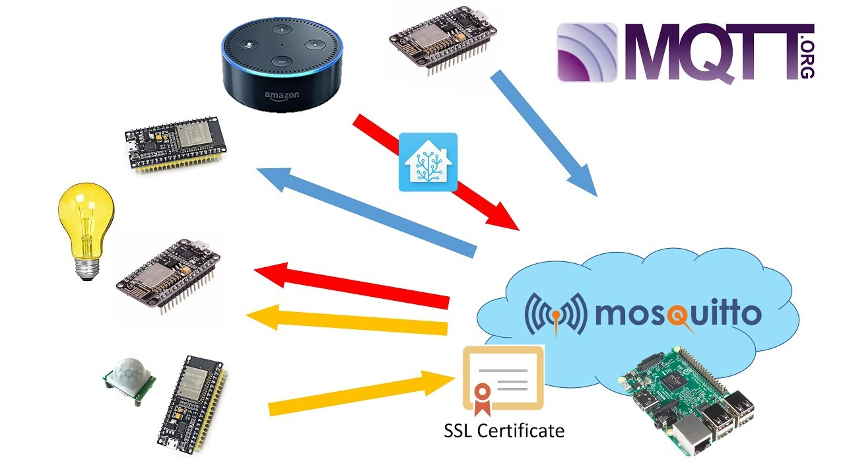
eMQTT, HiveMQ, Moquette

Slide 35
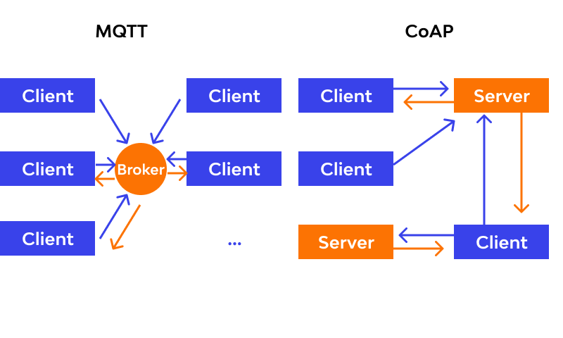
MQTT and CoAP

Slide 36
